Slide 1
QAPCO’s Chemicals and Waste Management Systems
Presented by: Noor Al Tamimi
Head of Environment Section

Slide 2
Content
QAPCO’s HSE Principles
Chemicals Management System
Waste management System
Physical Hazards:
Flammable
Explosive
Reactive
Health Hazards:
Corrosive
Toxic
Environment
Harmful to the environment

Slide 3
QAPCO’s Products and applications
Ethylene
LDPE
LLDPE
Sulphur
QAPCO in just about everything…

Slide 4
Domains In Operations Management
People
Personal
Equipment
Machines
Tools
Process
Production Processes
Materials
Environment
Raw Materials
Contractors
Installations
End Products
Waste
Workers environment
Environment
Work Processes

Slide 5
What are the risks?
Identify
All the potential loss exposures and risks; all the things that could go wrong.
Evaluate
The risk by considering the severity, the probability, and frequency of exposure
Develop
the System to ensure the desired results are occurring. If not…why not?
Implement
Monitor
a Plan to control the most significant risks.
The defined plan
Notes:
There are 5 major steps in managing risk:
Identification: when we identify risks associated with chemical handling for example. We gather a team consist of members from HSE and operation. Then we assess the situation trying to identify all the risks could occur from all prospective, such as identify all risks emerging from the nature of the chemical then look, identifying risks emerging from the environment surrounding the chemical, also from the handling activity itself.
So do brain storming and we list everything could go wrong.
Then we visit each identified risk and evaluate it against 3 criteria: Severity, Probability and Frequency. After evaluating we will be able to rank the risks from the most significant risk to the least significant one.
We start with the significant risks and develop a plan to reduce the risk to an acceptable level.
Implementation of the defined plan
Monitoring, finally we monitor the effectiveness of the implemented controls.

Slide 6
Context of HSE Culture
Safety Based on rules
Safety based on Initiatives
Safety Performance
Regulations
Requirements
Automation
Internal procedures
Protocols
Rules….
Expertise
Adaptability
Learning ability….
Rule Compliance
Initiatives
Notes:
QAPCO’s HSE Culture emerges from two major component,
1- Safety rules which obtained from Regulations ……
2- Initiatives from the company experts and employees, lesson learned …

Slide 7
Content
QAPCO’s HSE Principles
Chemicals Management System
Waste management System
Physical Hazards:
Flammable
Explosive
Reactive
Health Hazards:
Corrosive
Toxic
Environment
Harmful to the environment

Slide 8
Chemicals Management System
Chemicals Assessment & Approval
Chemicals Handling
Chemicals Storage
Chemical Hazard Communication
Monitoring
Emergency Response Planning

Slide 9
Chemicals Assessment & Approval
Team selection
Examination
Issuance of HSE Approval Certificate.
Notes:
Before any new Process chemical procured in QAPCO, it must be subject to a review of its suitability for use in the context of HSE risks under normal conditions and emergency situations. During this review all the potential impacts (toxicity, flammability, reactivity,…) on the people and environment will be reviewed by a team.
The review will include consideration of current MSDS information and any other relevant data, including quantity of material to be handled, potential exposure routes and risks. The mechanism for this chemical HSE assessment will include:
Team selection: members from HSE, Process Engineering, and user department.
Examination: All HSE impacts of the chemical will be reviewed based on information collected though MSDS and other sources. Each indicated potential hazards will be reviewed point by point on its impact on personnel, environment, process and equipment.

Slide 10
Chemicals Management System
Chemicals Assessment & Approval
Chemicals Handling
Chemicals Storage
Chemical Hazard Communication
Monitoring
Emergency Response Planning

Slide 11
Chemicals Handling
Hazard Identification and assessment
Adverse effects Identification
Controls Identification
Notes:
1- Hazard Identification and assessment:
The first thing to consider in the form in which the chemical is present (e.g. solid, liquid or gas), this influences the way in which the chemical is presented to the body and hence the risk.
2- Adverse effects Identification:
We try to answer this question “what is the threat?”
In order to do so we look at deferent factors which can influence the effect of chemicals to humans, such as:
Chemical characteristics: composition, hazardous & physical characteristics, stability and storage characteristics.
Exposure: Dose, duration and frequency of exposure…
Occupation Environment: Temperature and humidity, ambient atmospheric conditions, light and other form of radiation, occupational hygiene factors.
Effects of chemical by different routes: Inhalation, Skin contact, Eye contact, Ingestion
3- Identification of Controls:

Slide 12
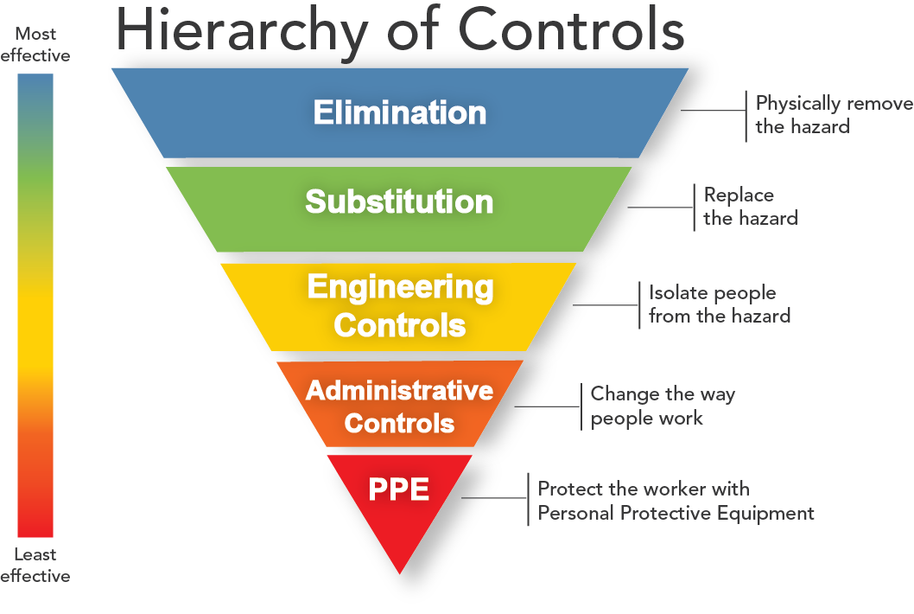
Hazard Control
Notes:
Elimination: Redesign the job or substitute a substance so that the hazard is removed or eliminated. For example, duty holders must avoid working at height where they can.
Substitution: Replace the material or process with a less hazardous one. For example, use a small MEWP to access work at height instead of step ladders. Care should be taken to ensure the alternative is safer than the original.
Engineering controls: Use work equipment or other measures to prevent falls where you cannot avoid working at height. Install or use additional machinery such as local exhaust ventilation to control risks from dust or fume. Separate the hazard from operators by methods such as enclosing or guarding dangerous items of machinery/equipment. Give priority to measures which protect collectively over individual measures.
Administrative controls: These are all about identifying and implementing the procedures you need to work safely. For example: reducing the time workers are exposed to hazards (eg by job rotation); prohibiting use of mobile phones in hazardous areas; increasing safety signage, and performing risk assessments.
Personal protective equipment Only after all the previous measures have been tried and found ineffective in controlling risks to a reasonably practicable level, must personal protective equipment (PPE) be used. For example, where you cannot eliminate the risk of a fall, use work equipment or other measures to minimize the distance and consequences of a fall (should one occur). If chosen, PPE should be selected and fitted by the person who uses it. Workers must be trained in the function and limitation of each item of PPE.

Slide 13
Chemicals Management System
Chemicals Assessment & Approval
Chemicals Handling
Chemicals Storage
Chemical Hazard Communication
Monitoring
Emergency Response Planning

Slide 14
Chemicals Storage
Stores
Catalyst Storage Area
Lab Chemicals Store
Shaded Storage Areas
Chemicals Store Warehouse

Slide 15
Chemicals Management System
Chemicals Assessment & Approval
Chemicals Handling
Chemicals Storage
Chemical Hazard Communication
Monitoring
Emergency Response Planning

Slide 16
Chemical Hazard Communication
Information
Training
Record Keeping
Incident Management
Product Labeling
Safety Hazard Operational Cards / Boards
MSDS
Detailed Technical Advice
Notes:
Record Keeping:
Where risk assessments are conducted and/or Job Safety Assessment done, a record of the significant finings and any resulting control measures found to be required must be kept, for future references. Also training records must be maintained.

Slide 17
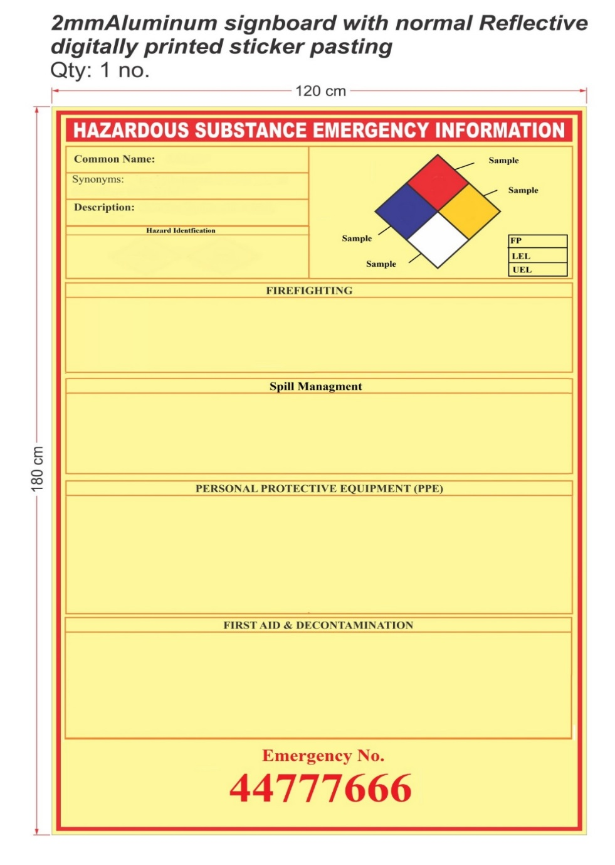

Slide 18
Chemicals Management System
Chemicals Assessment & Approval
Chemicals Handling
Chemicals Storage
Chemical Hazard Communication
Monitoring
Emergency Response Planning

Slide 19
Content
QAPCO’s HSE Principles
Chemicals Management System
Waste management System
Physical Hazards:
Flammable
Explosive
Reactive
Health Hazards:
Corrosive
Toxic
Environment
Harmful to the environment

Slide 20
Waste Management System
Waste Classification & Identification
Waste Collection Points
Waste Inspection
Internal Waste Transfer
Waste Inspection
Waste Storage Yard (WSY) Management
Waste Disposal
WSY Inspections
WSY Entry Pass
Notes:
Waste Classification and Identification:
- Domestic Waste
Non-hazardous industrial waste
Hazardous industrial waste

Slide 21
Notes:
Waste Classification and Identification:
- Domestic Waste
Non-hazardous industrial waste
Hazardous industrial waste

Slide 22
Waste Management System
Waste Classification & Identification
Waste Collection Points
Waste Inspection
Internal Waste Transfer
Waste Inspection
Waste Storage Yard (WSY) Management
Waste Disposal
WSY Inspections
WSY Entry Pass

Slide 24
Waste Management System
Waste Classification & Identification
Waste Collection Points
Waste Inspection
Internal Waste Transfer
Waste Inspection
Waste Storage Yard (WSY) Management
Waste Disposal
WSY Inspections
WSY Entry Pass

Slide 25
Thank You

